Slide 1
What is solid state physics?
Solid state physics (SSP) explains the properties of solid materials which follow from Schrödinger’s equation for a collection of atomic nuclei and electrons interacting with electrostatic forces.
SSP, also known as condensed matter physics, is the study of the behavior of atoms when they are placed in close proximity to one another. Many of the concepts are relevant to liquids too.
Notes:
Mention this is why I asked about SE on the pre-test. Most people didn’t remember much about it, and that’s ok. Honestly, for an undergraduate class, we won’t need to use the SE that much, but note that a lot of the properties that we will explore come from its application.
In fact, condensed matter physics is a much better name, since many of the concepts relevant to solids are also applied to liquids, for example.

Slide 2
What is the point?
Understanding the electrical properties of solids is right at the heart of modern society and technology.
The entire computer and electronics industry relies on tuning of a special class of material, the semiconductor, which lies right at the metal-insulator boundary. Solid state physics provide a background to understand what goes on in semiconductors.
Notes:
Might be good to mention here how this fits in with the structure of the class. In class, we start with atoms, go to bonding, discuss crystal structure and finally get into how this affects the properties of materials.
There are graduate level text books that jump directly into metals versus insulators, but those books are pretty challenging at this level. You’ll get there!

Slide 3
Chips Act: Rare Bipartisan Agreement It’s so important, the government realizes we have to have it made in America. (cause of inflation in cars)
Notes:
Congress does almost nothing in a bipartisan fashion these days. The bill for veterans wasn’t even bipartisan!
And this is just semiconductors, solid state physics is also critical for another government priority (next slide)

Slide 4
Inflation Reduction Act $369 billion in energy security and climate change
Notes:
64b in health care
124b in tax enforcement

Slide 5
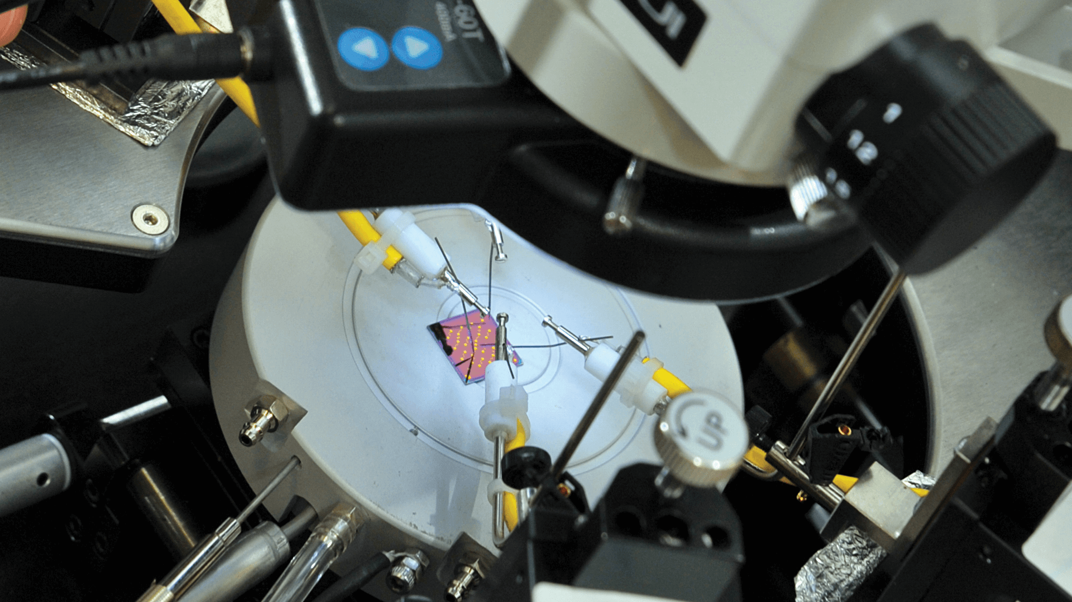
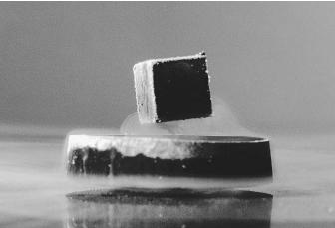
Why is Solid State Physics Important?
Electronic Properties
Transistors (the heart of electronics)
Electron/Photon Interactions
Laser Diodes, Photodiodes, CCDS
Electron/Phonon Interactions
Piezoelectric materials
Electron Spin/Charge Interactions
Spintronics, Quantum Computing
Highly Correlated Electronics Systems
Superconductors, Magnets
New technology for the future will involve developing and understanding new classes of materials. By the end of this course we will see why this is a non-trivial task.

Slide 6
What do pencil lead and diamonds have in common?
What property are they complete opposites?

Slide 7
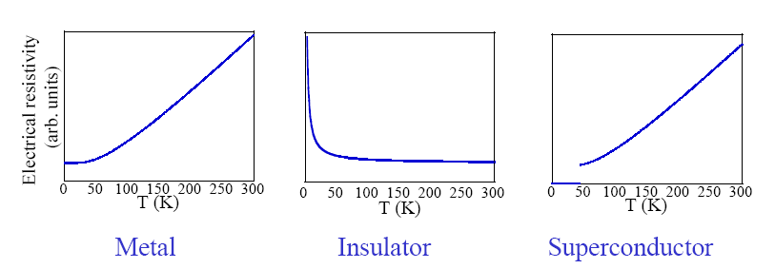
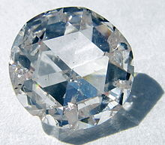
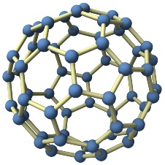
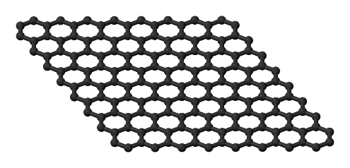
Electrical resistivity of three states of solid matter
They are all just carbon!
How can this be? After all, they each contain a system of atoms and especially electrons of similar density. Graphite is a metal, diamond is an insulator and buckminster-fullerene is a superconductor.
Notes:
The difference is the structure. Thus the structure of how atoms line up can have a significant impact on their properties.

Slide 8
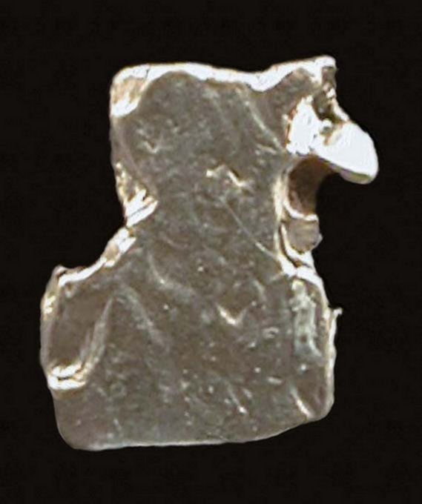
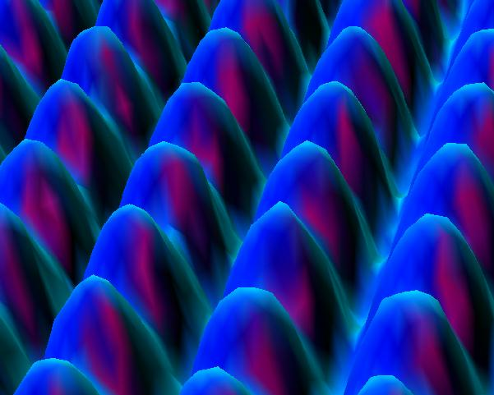
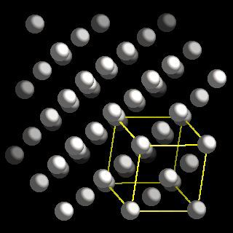
What is crystallography?
The branch of science that deals with the geometric description of crystals and their internal arrangement.
Platinum
Platinum surface
Crystal lattice and
structure of Platinum
(scanning tunneling microscope)
Notes:
Throwing the examples to the beginning

Slide 9
Structure of Solids Objectives
By the end of the next two classes you should be able to:
Identify a unit cell in a symmetrical pattern
Identify a crystal structure
Compare bcc, fcc and hcp crystal structures
Calculate atomic packing factors
Notes:
Generally, if crystal not cubic but close, we treat as pseudocubic and use cubic distances.
Today is all about real space. Next time we move into reciprocal space.

Slide 10
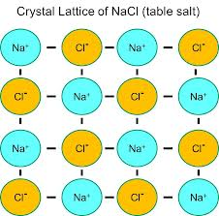
Crystal Lattice = an infinite array of points in space
Notes:
No, surroundings would not be identical. But, it doesn’t matter which you pick. You could even put the lattice points in between if you want. It makes no difference.
If plan to skip some of the upcoming slides (to 15), then should ask here how to define this 2D unit cell. (Obviously a little more complicated in 3D, but good practice.)

Slide 11
Crystal Lattice = an infinite array of points in space
Each lattice point has identical surroundings.
Arrays are arranged exactly in a periodic manner.
Notes:
No, surroundings would not be identical. But, it doesn’t matter which you pick. You could even put the lattice points in between if you want. It makes no difference.
If plan to skip some of the upcoming slides (to 15), then should ask here how to define this 2D unit cell. (Obviously a little more complicated in 3D, but good practice.)

Slide 12
Could the centers of both Na and Cl be lattice points at the same time?
Crystal Lattice = an infinite array of points in space
Each lattice point has identical surroundings.
Arrays are arranged exactly in a periodic manner.
Notes:
No, surroundings would not be identical. But, it doesn’t matter which you pick. You could even put the lattice points in between if you want. It makes no difference.
If plan to skip some of the upcoming slides (to 15), then should ask here how to define this 2D unit cell. (Obviously a little more complicated in 3D, but good practice.)

Slide 13
Crystal Structure =Lattice +Basis
Crystal structure can be obtained by attaching atoms, groups of atoms or molecules, which are called the basis (AKA motif) to every lattice point.
AKA means “also known as”
Notes:
Being silly here to highlight that a crystal structure is more than just the lattice. They are often confused.

Slide 14
Crystal Structure =Lattice +Basis
Crystal structure can be obtained by attaching atoms, groups of atoms or molecules, which are called the basis (AKA motif) to every lattice point.
AKA means “also known as”

Slide 15
Defining lattice points and unit cells (will help us better understand vectors)
P
a₂
A
a₁
What are the lattice points (integers) for points D, F and P, where point A is the origin?
Notes:
Mention what the integers are for B before making them do others. (1,0)

Slide 16
Defining lattice points (will us better understand vectors)
P
a₂
A
a₁
Point D (n1, n2) = (0,2)
Point F (n1, n2) = (0,-1)
Point P (n1, n2) = (3,2)
What are the lattice points (integers) for points D, F and P, where point A is the origin?
Notes:
Mention what the integers are for B before making them do others. (1,0)

Slide 17
Defining a lattice means writing lattice vectors
To be a Bravais lattice, lattice must look identical from each lattice point.
A Bravais lattice is a set of points such that a translation from any point in the lattice by a vector;
R = u₁ a₁ + u₂ a₂
locates an exactly equivalent point, i.e. a point with the same environment. This is translational symmetry.
The vectors a₁ and a₂ are known as lattice vectors and (u₁, u₂) is a pair of integers whose values depend on the lattice point.
P
a₂
A
a₁
Point D (n1, n2) = (0,2)
Point F (n1, n2) = (0,-1)
Point P (n1, n2) = (3,2)
Notes:
Mention what the integers are for B before making them do others. B=(1,0)

Slide 18
Unit Cell in 2D
Typically has lattice vectors shown between lattice points.
The smallest component of the crystal (group of atoms, ions or molecules), which when stacked together with pure translational repetition reproduces the whole crystal.
The choice of
unit cell
is not unique.
2D-Crystal
S
S
b
S
S
a
Notes:
Purple arrowed rectangle shows a counter example where the lattice vectors are shown not between lattice points. Remember you can always more vectors in space as long as the magnitude and direction stay fixed.

Slide 19
2D Unit Cell example -(NaCl)
Can the box be a unit cell?
We define lattice points ; these are points with identical environments
Notes:
No.

Slide 20
Is this the minimum 2D unit cell size? Where would the lattice points be?
Count atoms
Lattice points should all have identical environments

Slide 21
Choice of origin is arbitrary - lattice points need not be atoms - but unit cell size should always be the same.

Slide 22
This is also a unit cell - it doesn’t matter if you start from Na or Cl

Slide 23
- or if you don’t start from an atom

Slide 24
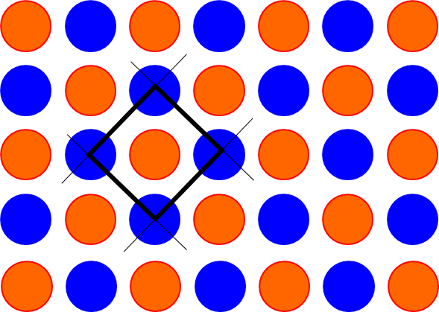
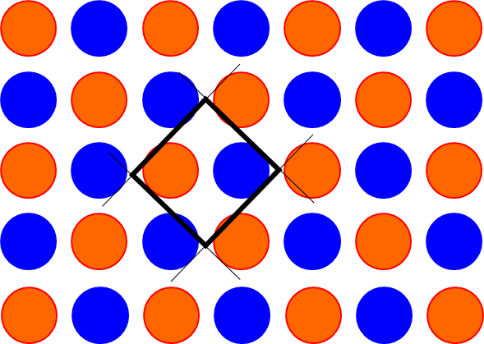
Crystal structure
Don't mix up atoms with lattice points! (e.g. NaCl)
Atoms can lie at positions other than lattice points (though typically not defined that way)
Crystal Structure = Crystal Lattice + Basis
Notes:
While it is common to put the lattice points at the position of an atom, it is not required and you will sometimes see the basis defined such that no atom is at (000). The diagram shows an example of such a definition.

Slide 25
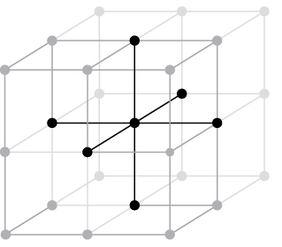
At each one of the circles in these cubes is a polonium atom. Fully define the crystal structure.
To define crystal structure fully, must define basis (with atoms) and lattice vectors.
Notes:
It’s simple cubic. Define Po at (0,0,0). Also write down lattice vectors.

Slide 26
Identifying the Lattice Parameters
(In your groups) determine the lattice vectors and basis for the smallest possible unit cell (more than one possible answer)
If you finish, draw the lattice.

